Slide 1
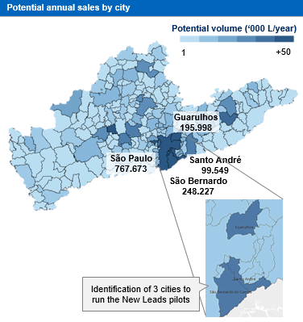
Leveraging granular PoS data and advanced analytics techniques can increase sales significantly for consumer goods players
BASIC MATERIALS (GEM) | WESTERN EUROPE
BAS005
Client context
Approach
Impact
Structured pilots in three cities with the highest potential for converting new leads
Developed a list of PoS with the highest churn probability and expected profit loss to hand out to the distributors
Prepared a “segment book” with tailored approaches and suggested combos to maximize cross sell
PoS served ‘000
New approach to Go to Market Strategy, leveraging McKinsey Advanced Analytics team as well as the client’s extensive database (combining public and proprietary sources) to:
Identify over 100k new customer leads for the ~30 distributors to persue, with PoS phone numbers and addresses to facilitate 1st contact
Predict PoS churn and recover sales of inactive customers before it was too late
Cluster PoSs and suggest a targeted approach according to each segments’ needs and profitability
New leads segmented based on AA techniques
Before the project
80
Identified in the project
180
2,25x
Where is impact opportunity …
Public and proprietary databases are usually poorly explored by consumer goods players, leading to sub-optimal channel strategies
Without analytical support, dealers develop more extensively areas that are closer to its headquarters, leading to several white spaces
PoSs are often inactivated (churned) simply because the dealers cannot effectively plan and execute visits
Client name: X
Team set-up: X
Fees Structure: X
What was unique: X

Slide 2


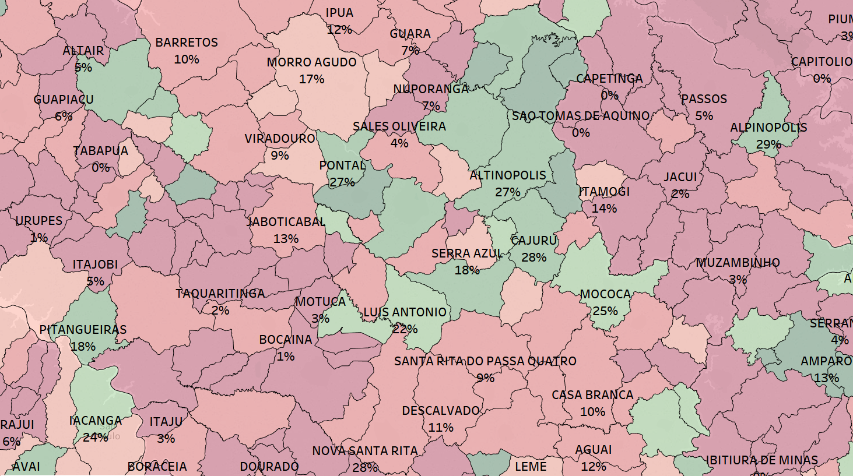
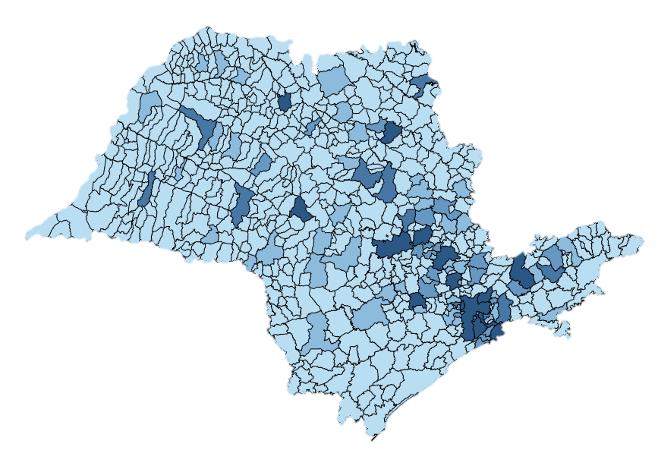


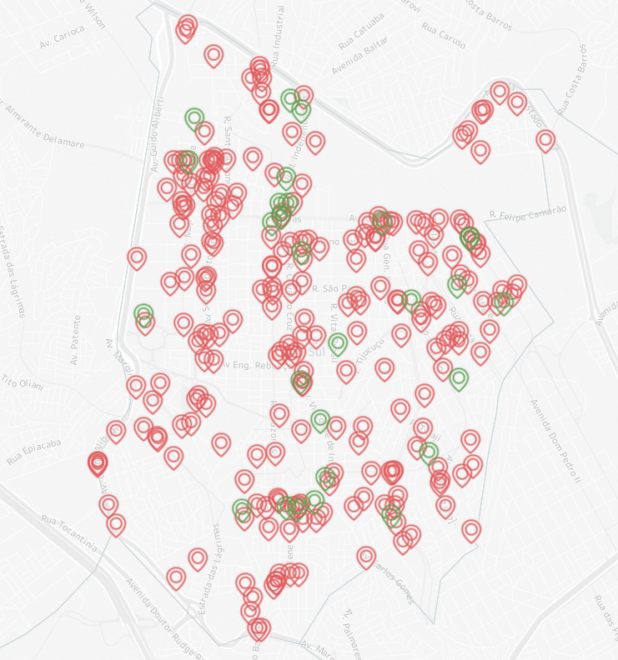

Geocoded data showed that distributors had a limited range of influence, creating huge areas of opportunity for our client
1
Unit of measure
Lubricant volume sold
State of São Paulo
Lubricant volume sold (m³/year)
Client Market share
2
+1500
0%
+40%
DA Ribeirão
Região de Araraquara foi uma das identificadas pelo DA Ribeirão como sendo pouco explorada
Only areas close to the dealers headquarters were being well explored
Public and proprietary databases allowed us to map new leads that could drive market share up in previously unexplored regions…
241 leads
28 current PoS
… leading to increased sales!

